Slide 1


Biology in a Box
A science education outreach program brought to you by a partnership
between The University of Tennessee and the National Institute for Mathematical and Biological Synthesis
Visit us on the web at http://biologyinabox.utk.edu
Biology in a Box Team
Program Director/Author/Lead Editor: Dr. Susan E. Riechert (University of Tennessee)
Science Collaborators: Dr. Thomas C. Jones (East Tennessee State University), Dr. Stan Guffey (University of Tennessee)
Mathematics Collaborators/Editors: Dr. Suzanne Lenhart (NIMBioS), Kelly Sturner (NIMBioS), Lu Howard (University of Tennessee)
Outreach Coordinator: Dr. Lynn Champion (University of Tennessee)
Workshop Coordinators: Kathy DeWein (Austin Peay State University), Gale Stanley (Jacksboro Middle School)
Production/Assistant Editor: J.R. Jones (University of Tennessee)
Previous Contributors: Sarah Duncan, Communications (formerly with NIMBioS), Rachel Leander, Math Collaborator (formerly with NIMBioS)
This unit revised July 2012
Copyright 2012 by Biology in a Box, and the University of Tennessee. All materials in this unit and on the Biology in a Box web server (biologyinabox.utk.edu, eeb.bio.utk.edu/biologyinbox) may not be reproduced or stored in a retrieval system without prior written permission of the publisher, and in no case for profit.

Slide 2
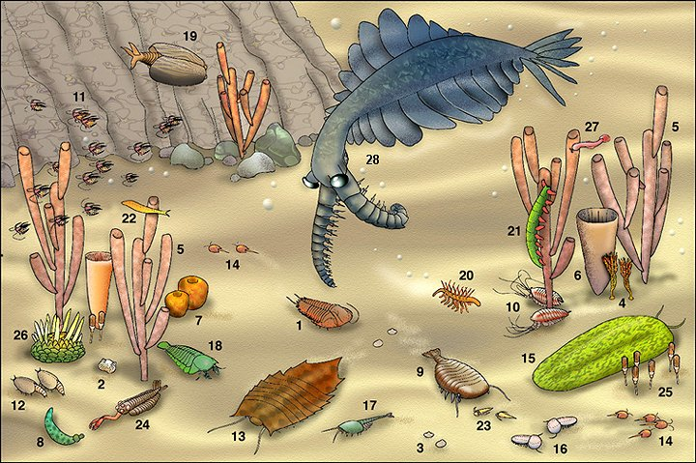
UNIT 1: FOSSILS - PART I

Slide 3
Homepage Unit 1: Fossils - Part I
Click underlined text below to go to information and exercises!
Materials List
Introduction
Exercise 1 - Fossils: T/F
Exercise 2 - Geological Time-Line
Mathematics in higher grade level version: Scientific notation, the laws of exponents, converting fractions to decimals and decimals to percents, measuring, understanding scale
Suggested Reading & Links
See file entitled “Unit 1 Fossils Part II” for Exercise 3 (Dating Fossils) and Exercise 4 (Fossil Lineages)
Clicking the icon on other slides
will bring you back to this page!

Slide 4
Materials List
2 clear plastic boxes labeled “Exercise 1. Fossils T/F” containing
  22 specimens (numbered 1-22) NOTE: #7 is currently unavailable!
Magnifying glass
Plastic deli cup labeled “Exercise 3c. Half-Life Experiment” containing:
  32 light-colored poker chips (with a colored dot on one side of each)
  32 dark-colored poker chips
Round plastic container holding a modern shark jaw

Slide 5
Materials List
Plastic bag labeled “Exercise 4. Fossil Lineages” containing
  Bag labeled “Exercise 4.1. Determining a Fossil Lineage” containing
    5 fossil shark teeth, each labeled and marked with a red dot:
      Cretolamna appendiculata
      Carcharocles auriculatus
      Carcharocles chubutensis
      Carcharocles megalodon
      Otodus obliquus
Bag labeled “Exercise 4.2. Comparing lineages” containing
  A single fossil shark tooth - Crow shark (Squalicorax pristodontus)

Slide 6
An Introduction to Fossils
Fossils are the remains of organisms
Dead, typically in excess of 10,000 years
Failed to decay
Preserved in some form of bacteria-free environment

Slide 7
The Student will …
Gain an understanding of what constitutes a fossil and mechanisms of preservation
Become familiar with the concept of geological time and what really big numbers of years mean
Learn about how dates are assigned to fossils
Learn how fossils are utilized to examine the historical relationships among organisms

Slide 8
Exercise 1. Fossils: T/F
Fossils are the remains or evidence of animals or plants that have been preserved naturally.
A deceased organism or evidence of it (e.g. footprints, burrows, excrement, etc.) becomes fossilized when it encounters an environment where it is protected from oxygen and bacteria that play major roles in the process of natural decay.
The general fossilization process varies greatly depending on the exact situation.
There are four basic kinds of fossils, which we will discuss on the next slide.

Slide 9
Four Basic Kinds of Fossils
The hard parts of the organism remain intact (e.g., tooth enamel, the shell of a mollusc).
Minerals have replaced the original animal or plant material. This is termed mineral replacement, and can be full or partial.
The animal or plant with tissue matter largely intact has been preserved in peat (acidic bogs), tar (tar pits), ice, or amber (the fossilized sap of pine trees).
The impression an organism made in a soft substrate has been preserved, while the organism itself is gone (trace fossil).

Slide 10
Living Fossils???
You may hear the term “living fossils” used to describe particular organisms.
These are organisms that are relics of a group that once was prominent but that is now largely extinct.
However, living fossils are not fossils in the true sense of the word, as they do not fit the definition of natural preservation.
You may encounter a living fossil in your set of items for this exercise!

Slide 11
Objectives…
Your goals in Exercise 1. Fossils T/F are to examine the mystery objects available and decide:
  1. Whether each is a fossil or not
(True or False)
2. If True, what the preservation mechanism was
3. Your guess as to what the object is

Slide 12
Directions
# | Fossil T/F | How preserved if ‘True’ | Object is? + notes after checking answer
1
2
3
4
5
6
7
8
9
n
Your teacher will lay out all of the items to be identified from box 1 at numbered stations around the room.
(Each item has the station number on it.)
Make a chart like the one shown here
*your chart should have 22 rows)

Slide 13
Exercise 1 Directions (continued)
Fill in your chart by doing the following:
  Visit a station and examine the object at it and determine whether it is a fossil or not.
  Record your decision (T) or (F) on the chart next to the number that corresponds to the object.
  Next, indicate the category of fossil you feel it is if you have answered true.
  Finally make a guess as to what the object is (e.g., tooth, leaf, piece of coal, rock).

Slide 14
Time to check your answers for Exercise 1
and to fill in the last column
For Answer list
For Picture key

Slide 15
Answer Key List
True
False
True
True
False
False
True
True
False
True
False
True
False
True
True
True
True/False
True
True
True
True/False
True
For answers with pictures, see table on next slide.
Click on the picture (not number in picture) for full information about each item.

Slide 16
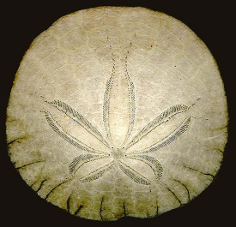
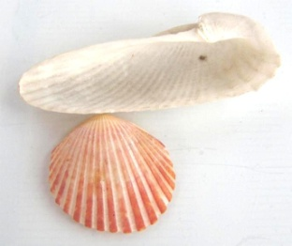
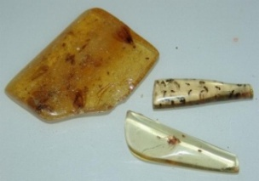
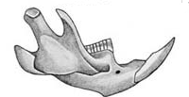
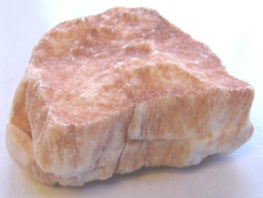
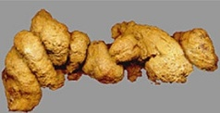
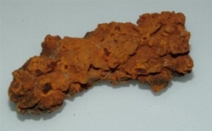
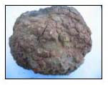
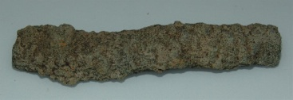
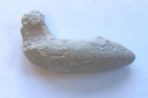
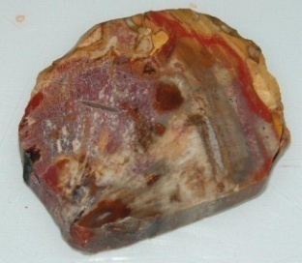

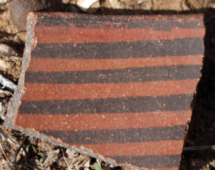
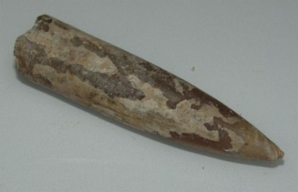

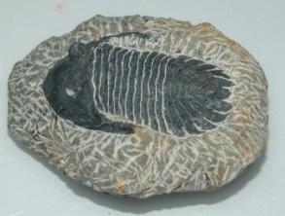

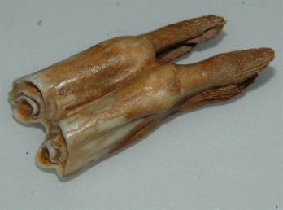
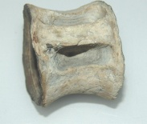
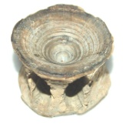
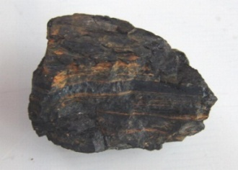
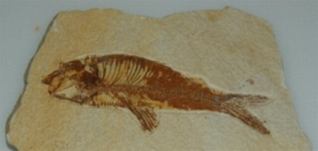
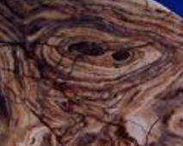
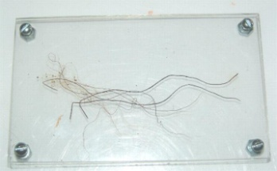
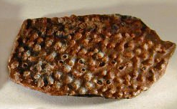
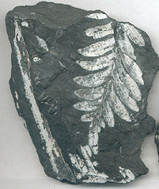
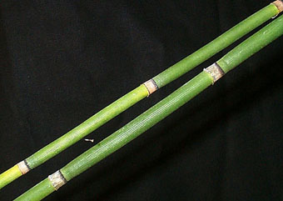
 | 2F | 3T | 4T
9 F
1T
5F
6F
8aT
7T
8bT
8dT
8cT
12T
11F
11F
10T
13F
13F
14T
17T/F
15a
T
15b,cT
16aT 16bT
22T
20T
19T
21T/F
18T

Slide 17
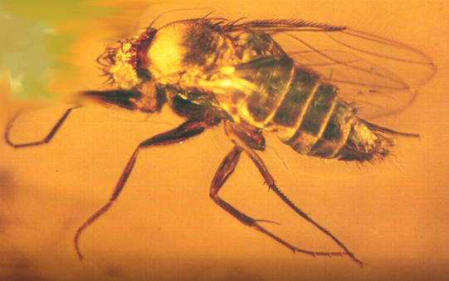

1. True. This is a piece of amber from South America that has a tiny insect(s) that lived 35 million years ago entombed in it. Like the fly in the picture below, your insect(s) became trapped in the sticky resin of a pine (Pinus sp.) tree as it landed on its bark. The resin or amber itself became hardened with the insect trapped inside. Scientists have obtained the genetic material (DNA) from insects preserved in amber.

Slide 18
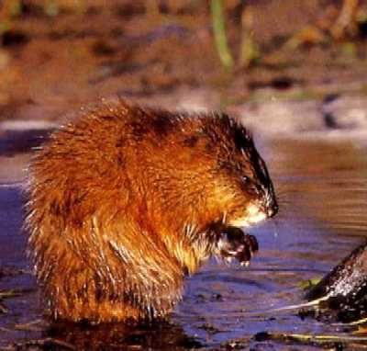
2. False. This is the lower jaw of a muskrat (Ondatra zibethicus) that died just a few years ago in the northwestern US.

Slide 19
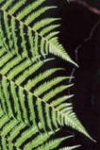
3. True. These are impressions of tree fern leaves (Alethopteris pennsylvanicus) that fell from trees about 213 million years ago in east Tennessee. Ferns were our major trees back then, and these fern trees were 130 feet tall. (How many meters is this?)

Slide 20

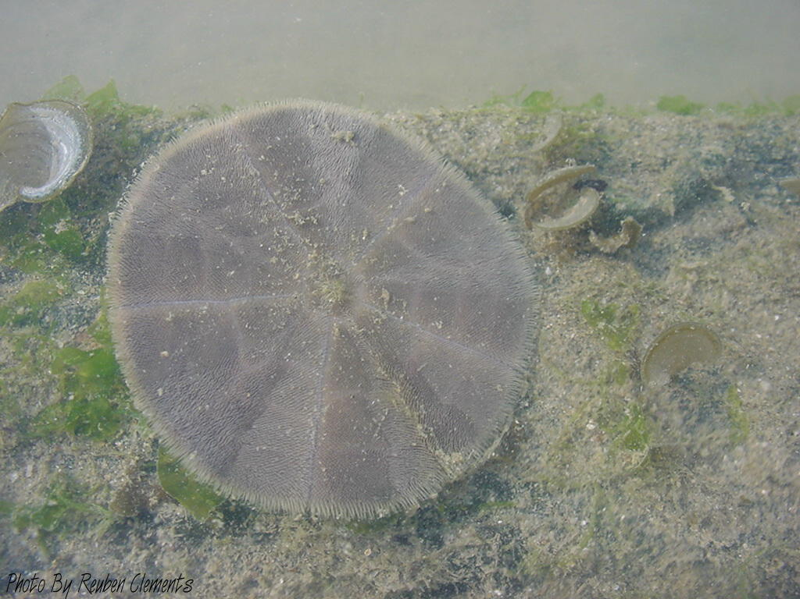
4. True. This is a sand dollar (an echinoderm, related to starfish) that lived in the seas between 36 and 42 million years ago. The specimen, probably Leodia sexiesperforata, was collected in North Carolina. The picture on the left is of a modern sand dollar. Limestone (calcium carbonate) has replaced the organism over time.

Slide 21

5. False. This is the shell of a clam that was washed up on a beach in Florida. A clam's shell is secreted by its mantle. Your clam died within the last 10 years, and the materials composing its shell have not been replaced by minerals.

Slide 22

6. False. This is a crystallized mineral (rock) called gypsum (calcium sulfate: CaSO₄), which is common to saline waters (have high levels of minerals dissolved in them). This piece was collected along the shore of a desert lake. Water rapidly evaporates from desert lakes, leaving minerals such as gypsum behind.

Slide 23
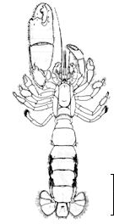

7. True. This is called a trace fossil. A ghost shrimp (phylum Arthropoda, subphylum Crustacea, class Decapoda), probably in the genus Calianassa) made a burrow that it sheltered in on the sea floor 10-20 million years ago, and the burrow itself has become replaced by limestone (calcium carbonate).
Fossilized shrimp burrow
Ghost shrimp

Slide 24
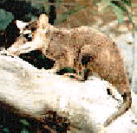

8. True. Fossils not only represent organisms themselves, but also the products they made when they were living. Smell this piece of coprolite. Coprolite is animal feces (poop), which has been replaced by minerals. It no longer smells like poop, because the organic material is long gone!
Two types of coprolite are in your box. Yours will be 2 of the 3 following possibilities.
  8a. This particular piece of coprolite was produced by a mammal, which lived about 4 million years ago. A reconstruction of what such an animal might look like is shown here. What modern organism(s) does it resemble?
8b &c on next slides

Slide 25
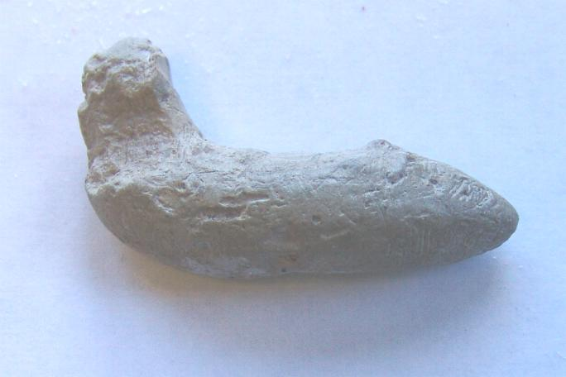
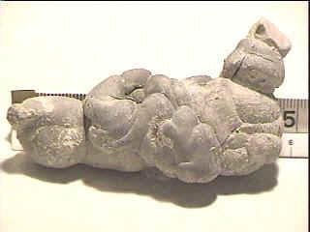
  8b. This piece of coprolite was produced by a shark or other fish 13-15 million years ago. Look for the impression made by the intestines of the animal that produced this fecal pellet.
8c on next slide

Slide 26
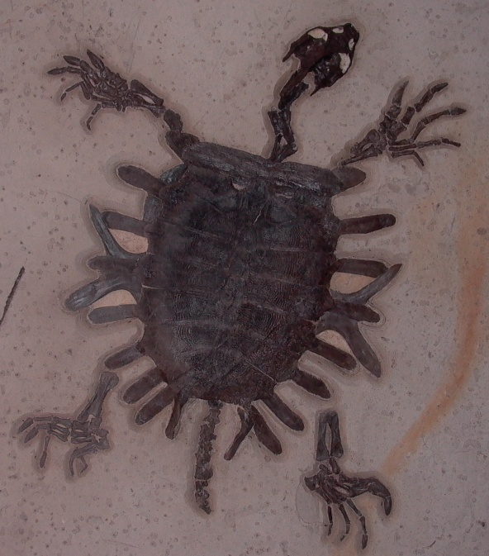

8c. This coprolite was produced by a sea turtle that visited a beach in Madagascar about 30 million years ago. Sea turtles visit the same beach today, but their poop has not been replaced by the mineral iron. Iron is found in the gravel at this beach.

Slide 27
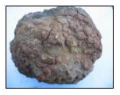
8d. This dinosaur coprolite came from a Utah fossil dig that covers the period 65-159 my. Thus, your fossil is no younger than 65 my, and no older than 159 my. The stone that replaced this dinosaur’s poop is agate. Check to see if you can find any bone fragments in the coprolite. If you find them, what can you say about this dinosaur’s diet?

Slide 28
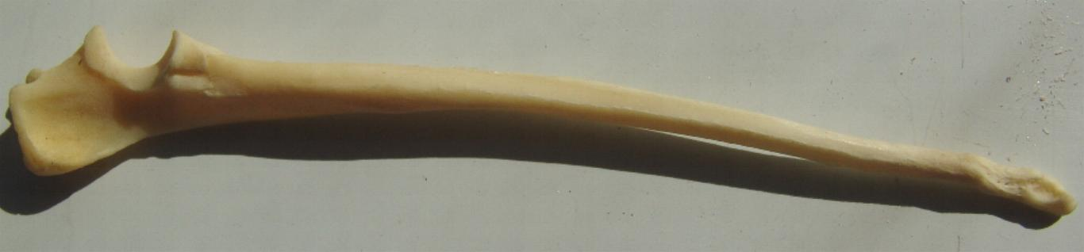
9. False. This is a tibia (leg bone) of a coyote (Canis latrans) that was recently killed on a road in the desert southwest USA.

Slide 29
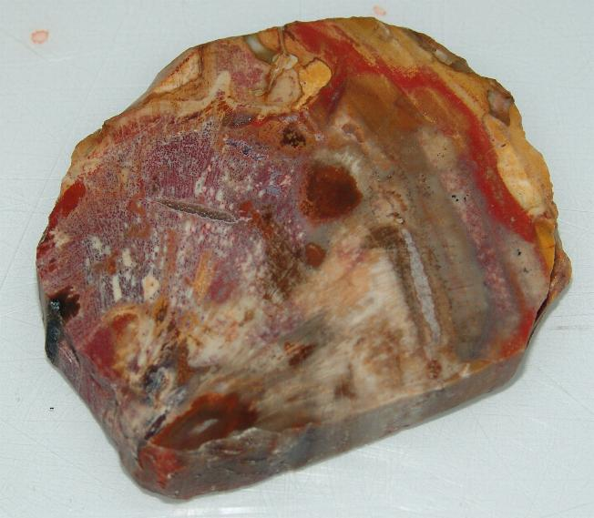

10. True. This is petrified wood from a tree that lived 340 million years ago. If your specimen is a cross section, you can see the growth rings that were added each year during the growing season. Some are rings are wider than others. Why? Your specimens were replaced, molecule by molecule, with mineral rich silica (sand) in water, forming agate.

Slide 30
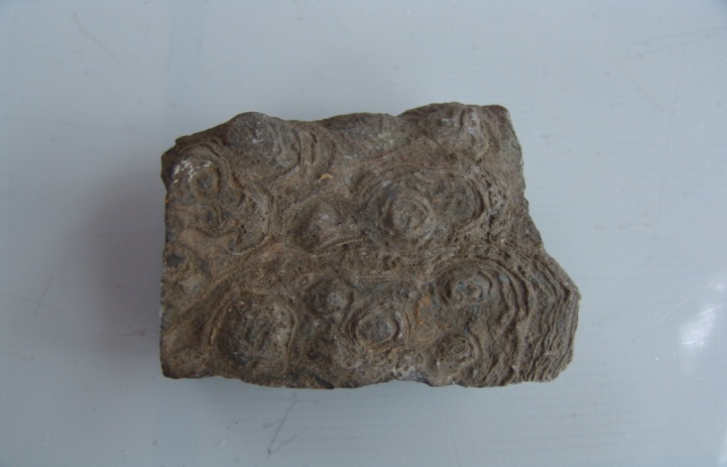
11. False. This is a concretion called a pseudofossil. It resembles a fossil, but consists of mineral matter that formed when minerals in water are deposited around some particle. The particle might have been another mineral or some piece of organic matter.
Concretions are similar to concrete. Since this material is frequently harder than the surrounding mineral matter, the matrix tends to erode away, leaving the concretion exposed.
Continued on next slide

Slide 31
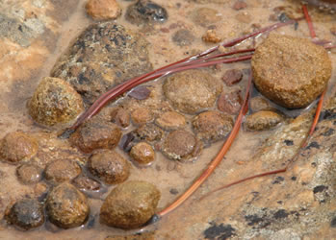
11 (cont.) You might have a particular concretion called a Moki Ball. It is an iron concretion that was formed about 30 my ago around sand crystals. The round shape is thought to be produced from the rolling of the concretion down sandstone cliffs in in Utah. The name comes from the Moki Indians that lived in the area and used the small metal balls to play games similar to our marbles. Medicine men also kept the balls in medicine bags, as they used them to help in healing their patients.

Slide 32

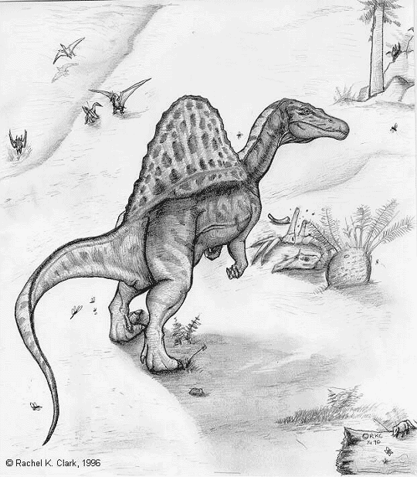
12. True
12a. This is the tooth of a meat-eating dinosaur called a spinosaurus (Spinosaurus marocanus) that lived 98-105 million years ago. The tooth has had mineral replacement, and was found in the Atlas Mountains of Morocco in Africa.

Slide 33
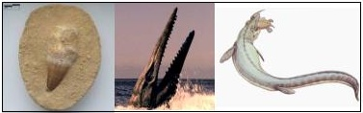
12b. Mosasaurus was a predator that inspired legends of dragons. The name means "Meuse lizard", because it was first found in the Meuse River in the Netherlands. This animal lived in the seas during the Age of Dinosaurs (70 million years ago), and obtained lengths of 10 meters (30 feet). Its streamlined body, powerful, paddle-like limbs, and huge jaws with numerous razor-like teeth allowed this animal to catch and consume large fish, turtles, mollusks, and shellfish. Your tooth was collected in Morocco, Africa.

Slide 34
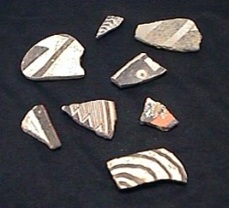
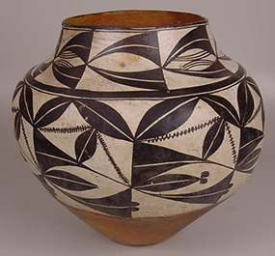
13. False. This is a pottery sherd that was produced by Pueblo Indians in northern New Mexico about 400 years ago. These Indians always broke their pots when being attacked by Apaches, so that the Apaches would not have the use of them. Former Pueblo Indian sites thus have huge mounds of pottery pieces called sherds.

Slide 35
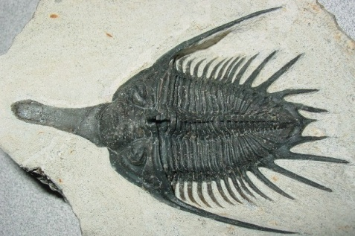

14. True. This is a trilobite (Elrathia kingi), one of the 10,000 species that lived in our seas over 500 million years ago. Before fish, the trilobites, squids, and octopi were the major predators in our oceans. All trilobites are now extinct (no species exist today). However, trilobites are ancient relatives of modern arthropods like insects and spiders. Your specimen was collected in ancient sea beds from Morocco. Its exoskeleton has been replaced by a carbon film, much as in an imprint or an impression.

Slide 36
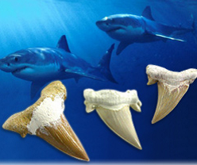
15a. True. This is a tooth of a mega-toothed shark (Carcharocles auriculatus) that is 2 million years old. The largest shark living today is about 30 feet long. Sharks that lived in our oceans millions of years ago were much larger. This tooth came from a shark that was probably over 40 feet long. The enamel is still present in its original form, though the bone has been replaced by minerals.
15b on next slide

Slide 37

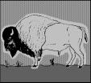
15b. True. Bison dispersed into North America from Asia during the Middle Pleistocene Era, 300,000 years ago. While native species of horse, llama, and elephant went extinct at the end of the Pleistocene, bison survived. This tooth is 4,000 years old, and is at the stage of partial mineral replacement. It is of the living species Bison bison. Fossils do not have to be material from extinct species!
15c on next slide

Slide 38
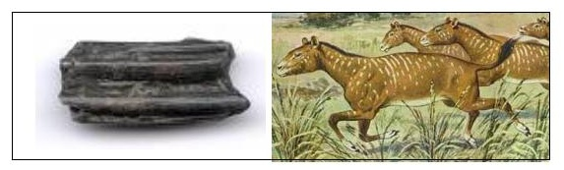
15c. Mesohippus bairdi was one of the earliest horses. This specimen is from a Mesohippus that lived in the South Dakota Badlands 30 million years ago in the Oligocene. This was a small horse of about the size of a domestic dog. Its skeleton closely resembled that of modern horses, but it carried its weight on three toes per leg, instead of on a single toe as horses do today. Its teeth also differ from those of a modern horse, which grazes on grasses. Mesohippus had low-crowned teeth, suggesting that it browsed leaves off trees and shrubs.

Slide 39
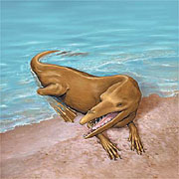

16a. True. This is a mammalian vertebra from an early small whale (cow whale) that was similar to our modern porpoise. The mineralized vertebra is between 3 and 5 million years old.
16b on next slide

Slide 40

Or……..
16b. You might have the vertebra of a ancient shark of about the same age. Mineral replacement has also occurred in the shark vertebra.

Slide 41
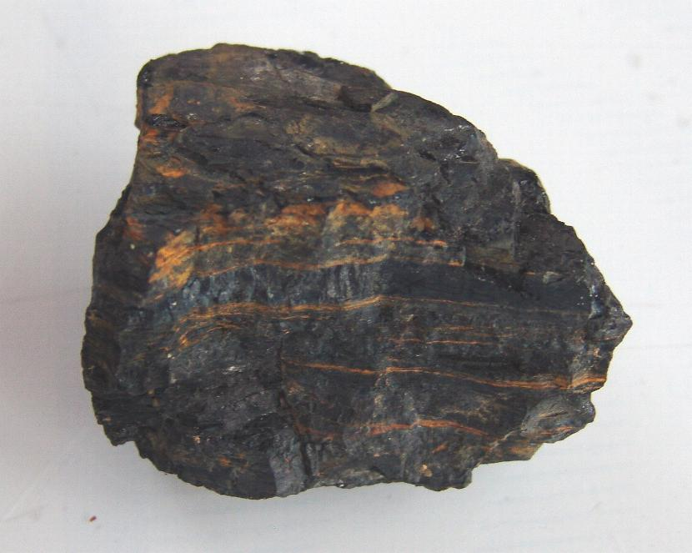
17. True and False. This is a piece of coal. Coal is a rock that consists of decomposed plants and animals that lived 299-359 million years ago. Because the organisms had decomposed into an organic soil called peat before heat and pressure formed the rock, coal is not a real fossil. It is referred to as a fossil fuel, though, and is burned today as a source of energy.

Slide 42

18. True. This is a fossil fish from the Liaoning province of north-east China that dates at 120 million years old. It belongs to the genus Lycoptera, and is related to modern fish that produce electric fields. This specimen was collected from a freshwater lake bed adjacent to a site where feathered dinosaurs have been found. It is an impression with minerals (iron replacing the carbon material film that was left as the animal decayed).

Slide 43
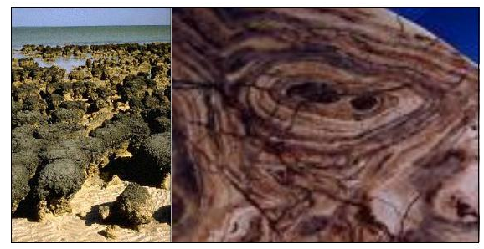

19. True. This specimen is a stromatolite that is 2.5 - 2 billion years old, and comes either from a stone quarry in Minnesota or California. Stromatolites are colonies of bacteria that create a limestone substrate to grow on. The cyanobacteria that form stromatolites are also the first organisms to make their own food using energy from sunlight (the first photosynthetic organisms). You can see the layers of algal mat produced by the colony in cross-section on your rock. Mineral rich silica dissolved in water replaced the algal mat.

Slide 44


20. True. This sample of hair comes from an extinct relative of the elephant, the wooly mammoth, Mammuthus primigenius. This hair was collected from an animal that was frozen in the permafrost in Siberia, Russia. The sample of hair is approximately 10,000 years old.

Slide 45

21. False. This is not a true fossil. It is part of the stem of a horsetail (genus Equisetum) that is only 1 m tall. The horsetails are referred to as living fossils, modern representatives of what was once a prominent group of trees in fossil history. Today the Equisetum resemble grasses.

Slide 46

22. True. This is a piece of an egg shell produced by a bird-like theropod dinosaur that was flightless, but that had feathers, presumably for warmth. These oviraptors (Oviraptosauria) are abundant in the fossil beds in Mongolia, China, and date about 100 my in the late Cretaceous (Age of Dinosaurs). Some workers feel that these are early birds that had lost the ability to fly, while most consider them dinosaurs.

Slide 47

Exercise 2. Geologic Time Scale
Introduction
  300 years ago, scientists started piecing together information about the earth’s geological history.
  They compared the patterns and ages of rock layers all over the world.
  The comparison resulted in a calendar called the geologic timescale, or planetary calendar.
  Rather than units of days and weeks like a standard calendar, the geologic timescale divides Earth’s history into sections called eras and periods, each of which is comprised of many millions of years.

Slide 48
Exercise 2. Geologic Time Scale
    For Grades K-4
    For Grades 4-6
For Grades 6-12, which includes:
Scientific notation, the laws of exponents,
converting fractions to decimals and decimals to percents, measuring, understanding scale

Slide 49
Exercise 2. Geologic Time Scale
Our planet is about 4.6 BILLION years old!
That is a really long time, equal to 4.6 thousand million years!
Thinking about such a long history may be hard to do, but in this exercise, you will explore major events in the history of our planet and life on it.
Your teacher will assign you (or let you choose) an event from Earth’s history from the following slide.
You should then draw a picture that illustrates this event, and label it.

Slide 50
Exercise 2. Geologic Time Scale
Present
Homo sapiens (humans)
First evidence of ice at the poles
Early horses
Early primates
Dinosaurs became extinct
Early flowering plants
Early birds and mammals
First dinosaurs
Early trees, formation of coal deposits
First reptiles
First insects
Early land plants
Early fish
Early shelled organisms
First known animals
Buildup of free oxygen in atmosphere
Early bacteria & algae
Oldest known Earth rocks
Formation of Earth's atmosphere
Formation of the Moon
Origin of earth

Slide 51
Exercise 2. Geologic Time Scale
Ahead of time, your teacher should have made a BIG timeline, around your classroom, in the hallway, or outside.
After you have drawn the picture of your event in Earth’s history, your teacher will show you where your event goes on the timeline.
After all pictures have been added, start at the end of the timeline with the origin of the earth, and walk along it, observing these important events.
Your teacher may tell you how much time, on average, your foot represents.
Look at how close and how far away certain events on the timeline are.
Talk about these events with your classmates.
You may even wish to invite other classes to view your timeline, and take a “field trip through Earth’s history”!

Slide 52
Introduction
We are used to calendars that are subdivided into months,weeks, and days.
The geological calendar divides Earth’s 4,500 million (4.5 billion) year history into sections called eras and periods, which are made up of millions of years.
How many zeros does it take to write out one million?
Six. 1,000,000 = a million years
How many zeros does it take to write out one billion years?
    Nine. 1,000,000,000 = a billion years
Scientific Notation
To save time, we write these numbers in exponent form:
What is the scientific notation for 1 billion?

Slide 53

The exponent (small number to upper right of 10) tells us the number of zeros that follow the 1.
What if the number does not start with 1?
Express 4,500 million years in scientific notation.
So,
We used the laws of exponents to convert 4,500 million years to 4.5 × 10⁹ years.
THE LAWS OF EXPONENTS

Slide 54
Exercise 2. Geologic Time Scale
In Exercise 2, you will construct your own version of the geologic time scale.
You will then use the charts you make to understand the age relationships
  among the fossils you have identified under Exercise 1,
  among another set of fossils used in Exercise 4.

Slide 55
Exercise 2a. Construction of a Planetary Calendar (for Higher Grades – with math!)
These instructions will help you construct a planetary calendar, or timeline, scaled to a single page.
Eras of geological time will be represented by segments of the timeline.
In order for this timeline to give an accurate representation of the past, segment length should be proportional to era length.
For example, if Era 1 lasted twice as long as Era 2, then the line segment for Era 1 should be twice as long as the line segment for Era 2.
In other words, the following ratio should be true for all segments:

Slide 56
Exercise 2a. Construction of a Planetary Calendar (for Higher Grades – with math!)
Make a 20.5 cm line down the length of a sheet of paper. Let the upper end be current time.
Make a mark at 0.3 cm down from the top of the line.
Make another mark at 1.1cm down from the top of the line
Make a third mark at 2.5 cm from the top of the line
You have demarcated the eras of the geological time scale.
Your timeline represents a period of 4,500,000,000 years (4.5 billion years, the age of the Earth).

Slide 57
Label each section of the line with its official geologic name, as follows:
  The long lower section below the 2.5 cm mark is Precambrian time
  The section immediately above this is the Paleozoic Era.
  Next is the Mesozoic Era.
  The section at the top is the current geological era, the Cenozoic Era.

Slide 58
What percentage of Earth’s history do each of the geological eras take up?
Let’s find the percentage of time that the Precambrian takes up together.
The length of the section prescribing the Precambrian is 20.5 cm - 2.5 cm, for a total of 18 cm.
Since the total line length is 20.5 cm long, we find that the ratio of this section’s length to the entire line’s length is
18/20.5 ≈ 0.88
That means that this section’s length is approximately 100 × 0.88 = 88% of the length of the entire line. Thus, Precambrian time makes up about 88% of Earth’s history - almost all of it!

Slide 59
Using the same technique, answer the following questions:
2a1 Q1. What percent of the total time does the Paleozoic Era take up?
2a1 Q2. What percent of the total time does the Mesozoic Era take up?
2a1 Q3. What percent of the total time does the Cenozoic Era take up?

Slide 60
Answer Time!
2a1 Q1. What percent of the total time does the Paleozoic Era take up?
  The Paleozoic Era takes up approximately 7% of the total time.
2a1 Q2. What percent of the total time does the Mesozoic Era take up?
  The Mesozoic Era takes up approximately 4% of the total time.
2a1 Q3. What percent of the total time does the Cenozoic Era take up?
  The Cenozoic Era takes up approximately 1% of the total time.

Slide 61
Precambrian time lasted for almost 4 billion years.
The first abundant fossils are the cyanobacteria (sometimes called “blue-green algae,” although they are not algae at all).
These prokaryotes (organisms lacking a nucleus) were the first photosynthetic organisms and colonies of them formed algal mats, fossils called stromatolites.
Question: Where on our time line is the point denoting the appearance of the first living organisms?

Slide 62


Answer Time!
Question: Where on our time line is the point denoting the appearance of the first living organisms?
Answer: Because this event occurred 3.5 billion (3500 million) years ago, the ratio of time since this event and the total time is
The ratio of the length of the line segment spanning this time and length of the entire timeline is also 0.78.
So that segment length= 0.78 × 20.5 cm ≈ 16.0 cm.
Thus the point denoting the appearance of the first life is 16.0 cm down from the top of the line.
Mark this point on your calendar with the label
“1st Life - Prokaryotes”.

Slide 63
Most major animal body plans appeared in the Paleozoic Era, during the first period called the Cambrian, which ended 488 million years ago (mya).
Using the technique from before, find the point on your timeline that denotes the the end of the Cambrian Period. Label this point “End of Cambrian Period”.
The three geologic eras are often given nicknames based on the dominant life forms during those eras:
    Paleozoic Era: “Age of Invertebrates” or “Age of Trilobites”
    Mesozoic Era: “Age of Reptiles” or “Age of Dinosaurs.”
    Cenozoic Era: “Age of Mammals”
Human history in geologic time isn’t big enough to be seen at the end of the calendar.
Write the era nicknames after each era name on your timeline.

Slide 64
Now that your geologic timeline has been constructed, use the information you wrote on your chart to place your fossils along this timeline.
Note: the Paleozoic Era involved diversification of life mostly in the seas.
  Land building activity by volcanoes and earthquakes in later eras led to the diversification of life on land. Plants & fungi also originated in new terrestrial environments created in the Mesozoic & Cenozoic.
You may have noticed that all of your fossils have been crowded into a very small part of the geological time line.
It will be informative for you to look at biodiversity in geological time a little more closely, which you will do in the next exercise.

Slide 65
Exercise 2b1. A Closer Look at
Biodiversity in Geological Time (Higher Grades)
Make a new scale on another sheet of paper to expand the time period during which multicellular life has diversified (the Cambrian through the present).
Draw a line 20.5 cm down the length of the paper. Let the upper end be the current time and the lower end be the start of the Cambrian period of the Paleozoic Era at 542 mya.
Use the information on the following slide to separate the expanded upper end of the time line into periods within eras from 542 mya to present. Use the mathematical technique described in Exercise 2a to find the points on the line that correspond to the beginning of each period.

Slide 66
Geological Periods from the Cambrian to Present
Era | Period | Beginning of Period (millions of years ago)
CENOZOIC | Quaternary | 2.6 mya
 | Tertiary | 65.5 mya
MESOZOIC | Cretaceous | 145.5 mya
 | Jurassic | 201.6 mya
 | Triassic | 251 mya
PALEOZOIC | Permian | 299 mya
 | Carboniferous | 359 mya
 | Devonian | 416 mya
 | Silurian | 444 mya
 | Ordovician | 488 mya
 | Cambrian | 542 mya

Slide 67
Exercise 2b. (continued) A Closer Look at
Biodiversity in Geological Time (Higher Grades)
Find and mark the position of each of your fossil samples from Exercise 1 on this new time line, using the same mathematical technique as before.
Which fossils were you unable to place on your abbreviated timeline?
These are the really ancient organisms!
Life has been around on Earth for about 3.5 billion years, but multicellular life (organisms made up of more than one cell) has only been around for a little over half a billion years (542 million), which is the time depicted in your abbreviated geological time line.
To further explore life during this time in more detail, go to the next slide!

Slide 68

The Geologic Time Scale: Exploring Life On Earth
Click a period to learn about life on Earth during that time.
Within eras, periods are sized to scale with respect to time. However, each era is not to scale with the others!
Buttons on period slides:
Return to this slide
Forward/back in time Exercise for higher grades
Go to homepage

Slide 69
Exercise 2C. Comparing Time Frames
Form teams, if you have not already done so.
Each team should compare the geological timeline you made after that on the following page to the one projected on a 24-hour clock.
Add the events listed on this clock to your timeline.
  Begin by finding the length of a single “hour” on your timeline. Hint: There should be 24 hours total on your timeline, and each hour should be of the same length.
Discuss how this comparison contributes to your understanding of geological time.
Which exercise was more meaningful to you, the drawing of geological time to scale, or the placement of our 24-hour clock on a geological timeline? Explain your answer.

Slide 70

1st Life

Slide 71
Exercise 2. Geologic Time Scale
In Exercise 2, you will construct your own version of the geologic time scale, and then use the charts you make to understand the age relationships among
  the fossils you have identified under Exercise 1
  other fossils used in Exercise 4.

Slide 72
Exercise 2a. Construction of a Planetary Calendar (Younger Students): Directions
Make a 20.5 cm line down the length of a sheet of paper. Let the upper end be current time.
Make a mark at 0.3 cm down from the top of the line.
Make another mark at 1.1cm down from the top of the line
Make a third mark at 2.5 cm from the top of the line
You have demarcated the eras of the geological time scale.
Add the information on the following slide to your timeline.

Slide 73
Formation of the earth = 4,500 mya (million years ago)
  This point is represented by the lower end of your line.
Start of Paleozoic Era = 542 mya
  This point is represented by the mark 2.5 cm from the top of your line.
End of Cambrian Period within Paleozoic Era = 488 mya
  This point is represented by the mark 2.2 cm from the top of your line.
Start of Mesozoic Era = 251 mya
  This point is represented by the mark 1.1 cm from the top of your line.
Start of Cenozoic Era = 65.5 mya
  This point is represented by the mark 0.3 cm from the top of your line.
First life (prokaryotes) become abundant in the fossil record at about 3.5 billion years ago – denoted by a point about 16.0 cm from the top of the line
  Mark this point as “1st life - prokaryotes” on your calendar.

Slide 74
Answer the following questions
Q1. Which era was the longest: the Paleozoic Era, or the Cenozoic Era?
Q2. Which occurred first, the beginning of the Mesozoic Era, or the beginning of the Cenozoic Era?

Slide 75
Time to check your answers!
Q1. Which era was the longest: the Paleozoic Era or the Cenozoic Era?
    The Paleozoic Era was the longest.
Q2. Which occurred first, the beginning of the Mesozoic Era or the beginning of the Cenozoic Era?
    The beginning of the Mesozoic Era occurred first.

Slide 76
Use the information you wrote on your chart in Exercise 1 to place your fossils along this timeline.
Hints:
  The Paleozoic involved diversification of life mostly in the seas.
  Major land building activity by volcanoes and earthquakes in the later eras led to the diversification of vertebrates, insects, spiders and their relatives on land.
  Plants and fungi also originated in the new terrestrial environments created in the Mesozoic and Cenozoic eras.
Click the back arrow to review Exercise 1 if necessary. Otherwise, click the forward arrow to move on.

Slide 77
Exercise 2b. A Closer Look at Biodiversity in Geological Time (Younger Students)
Make a new scale on another sheet of paper. Draw a line 20.5 cm down the length of the paper. Let the upper end be the current time and the lower end be the start of the Cambrian period of the Paleozoic Era at 542 mya (million years ago).
Measure out and mark off the following lengths from the top of the line: 18.5 cm, 16.8 cm, 15.7 cm, 13.6 cm, 11.3 cm, 9.5 cm, 7.6 cm, 5.5 cm, 2.5 cm, 0.1 cm. These marks denote the beginnings and ends of the periods listed on the next page.
Use the information on the next slide to label the segments of the expanded time line with period names.

Slide 78
Geological Periods from Cambrian to Present
Era | Period | Beginning of Period | Mark Denoting Beginning of Period
CENOZOIC | Quaternary | 2.6 mya | 0.1 cm
 | Tertiary | 65.5 mya | 2.5 cm
MESOZOIC | Cretaceous | 145.5 mya | 5.5 cm
 | Jurassic | 201.6 mya | 7.6 cm
 | Triassic | 251 mya | 9.5 cm
PALEOZOIC | Permian | 299 mya | 11.3 cm
 | Carboniferous | 359 mya | 13.6 cm
 | Devonian | 416 mya | 15.7 cm
 | Silurian | 444 mya | 16.8 cm
 | Ordovician | 488 mya | 18.5 cm
 | Cambrian | 542 mya | Bottom (20.5 cm)

Slide 79
Exercise 2b. (continued) - A Closer Look at Biodiversity in Geological Time (Younger Students)
Which fossils were you unable to place on your abbreviated timeline?
These are the really ancient organisms!
Life has been around on Earth for about 3.5 billion years, but multicellular life (organisms made up of more than one cell) has only been around for a little over half a billion years (542 million), which is the time depicted in your abbreviated geological time line.
To further explore life during this time, click the arrow button!

Slide 80


Cambrian Period
(542-488 Million Years Ago)
Invertebrates, including arthropod predators, the trilobites (now extinct) appeared, are abundant.
Most currently existing major body plans of animals appear, as well as many bizarre organisms.
Rapid diversification during this period is often referred to as the “Cambrian Explosion.”
The Burgess Shale in Canada is famous for lots of Cambrian fossils.

Slide 81


Ordovician Period
(488-444 Million Years Ago)
Marine invertebrates diversify even further.
Jawless, armored fish known as ostracoderms, the first vertebrates, appear.
Possible first non-vascular plants (without specialized tissues to transport water & nutrients) on land.
End of period marked by the second largest extinction of marine life in Earth's history.

Slide 82



Silurian Period
(444-416 Million Years Ago)
Jawless fish diversify rapidly.
The first jawed fishes (acanthodians) appear.
First vascular land plants.
Forests of mosses lined streams and lakes.
Signs of early terrestrial food webs, including the first arachnids and centipedes, indicating that arthropod prey was present.

Slide 83


Devonian Period
(416-359 Million Years Ago)
Reefs of corals and red algae, with lots of invertebrates.
Coil-shelled cephalopods called ammonoids appeared.
Fish diversified, including lobe-finned fishes that evolved into amphibians near end of the period.
Giant mosses & ferns, early seed plants on land.
Another major extinction wiped out lots of invertebrates (including most trilobites) and jawless fish.

Slide 84


Carboniferous Period
(359-299 Million Years Ago)
Bony fish and sharks similar to modern groups.
First freshwater clams.
Humid, tropical climates with no well-defined seasons.
Swampy forests of ferns and their relatives.
Winged insects (cockroaches, mayflies, dragonflies) attained huge sizes.
Numerous amphibians.
First lizard-like reptiles.

Slide 85


Permian Period
(299-251Million Years Ago)
Earth's landmasses drifted together to form Pangaea.
Diversification of terrestrial fungi, arthropods, and plants.
Early conifers (similar to modern pines).
Radiation of reptiles.
At end of period, largest extinction of marine life in Earth's history, with around 96% of marine life (including all trilobites) wiped out.

Slide 86


Triassic Period
(251-201.6 Million Years Ago)
Sea life began to recover.
On land, seed plants and insects diversified further.
Many reptiles, including plant eaters, meat eaters, flying reptiles (pterosaurs), giant aquatic reptiles (ichthyosaurs, plesiosaurs, pliosaurs, and giant sea turtles) appeared.
By end of Triassic, representatives of all modern tetrapods (with birds represented by dinosaurs) were present.

Slide 87


Jurassic Period
(201.6-145.5 Million Years Ago)
Giant herbivorous dinosaurs, and smaller predators.
Pterosaurs abundant in the skies, and Archaeopteryx, the first bird, appeared.
Large marine reptiles at their most abundant, as well as sharks and rays similar to modern forms.
Terrestrial mammals diversified, but still relatively sparse.
Earliest known aquatic mammal appeared.

Slide 88


Cretaceous Period
(145.5-65.5 Million Years Ago)
Earliest deciduous trees & flowering plants.
Rapid increase in insect diversity (including first butterflies and ants).
T. rex and mosasaurs appear.
First marsupials (mammals that carry young in mother's pouch).
Diversification of birds.
Dinosaurs (except birds) & large marine reptiles all went extinct at end of period, perhaps due to one or more meteor impacts, though increased volcanic activity & falling sea levels may have played a role.

Slide 89


Tertiary Period
(65.5-2.6 Million Years Ago)
With dinosaurs gone, mammals became the dominant vertebrates.
Monotremes (egg-laying mammals) appeared.
Odd-toed ungulates (relatives of horses, deer, and rhinos).
Even-toed ungulates (relatives of sheep, goats, camels, etc.)
First elephants with trunks, and early horses.
Nearly all modern flowering plant families represented by middle period.
Global cooling towards the end of the period, with ice sheets at the poles.

Slide 90


Quaternary Period
(2.6 Million Years Ago to Present)
Earth experienced multiple glaciations (ice ages) from the early part of this period, until about 10,000 years ago, when more modern climates came into play.
More mammals appeared, including many now extinct ones.
  Saber-toothed tigers
  Wooly mammoths & mastodons
  Glyptodonts (giant armadillos)
  Giant ground sloths
Modern man appears.

Slide 91



Suggested Reading – Younger Students
Grades K-3
Encyclopedia Prehistorica Mega-Beasts Pop-Up - Robert Sabuda and Matthew Reinhart
Dinosaurs!: The Biggest Baddest Strangest Fastest - Howard Zimmerman
Mammoths on the Move - Lisa Wheeler and Kurt Cyrus (Illustrator)
Dinosaurs of Waterhouse Hawkins - Barbara Kerley
Boy, Were We Wrong About Dinosaurs! - Kathleen V. Kudlinski and S.D. Schindler (Illustrator)
Smithsonian Rock and Fossil Hunter - Ben Morgan & Douglas Palmer
Stone Girl, Bone Girl: The Story of Mary Anning - Laurence Anholt & Sheila Moxley (Illustrator)
Grades 4-7
Dinosaurs Walked Here and Other Stories Fossils Tell - Patricia Lauber
Geology Rocks! 50 Hands-On Activities to Explore the Earth - Cindy Blobaum & Michael Kline
Bodies from the Ice: Melting Glaciers and the Recovery of the Past – James M. Deem
Bones Rock!: Everything You Need to Know to Be a Paleontologist - Peter Larson & Kristin Donnan
Uncovering the Mysterious Wooly Mammoth - Michael Oard
Fossils - Trudi Strain Trueit
Dinosaurs!: Battle of the Bones - Sharon Siamon
Is There a Dinosaur in Your Backyard?: The World's Most Fascinating Fossils, Rocks, and Minerals - Spencer Christian & Antonia Felix

Slide 92



Suggested Reading – Higher Grades
Grades 7+
Dinosaur Tracks and Other Fossil Footprints of the Western United States - Martin Lockley and Adrian P. Hunt
Reading Between the Bones: The Pioneers of Dinosaur Paleontology - Susan Clinton
Dinosaurs: The Most Complete, Up-to-Date Encyclopedia for Dinosaur Lovers of All Ages - Dr. Thomas R. Holtz Jr. & Luis V. Rey (Illustrator)
Fossil Legends of the First Americans - Adrienne Mayor
An Introduction to Fossils and Minerals: Seeking Clues to the Earth's Past - Jon Erickson
Scientific Journal Articles (PDFs included on Teacher CD!)
Botella, H., J.I. Valenzuela-Rios, and C. Martinez-Perez. Tooth replacement in early chondrichthyans: a qualitative approach. Lethaia 42:365-376.
Hone, D.W.E. and O.W.M. Rauhut. Feeding behaviour and bone utilization by theropod dinosaurs. Lethaia. 10.1111/j.1502-3931.2009.00187.x
Sánchez et al. Cleptoparasitism and detritivory in dung beetle fossil brood balls from Patagonia, Argentina. Palaeontology 52(4): 837-848.

Slide 93
Links (Underlined text is clickable!)
General Information on Fossils and Earth’s Geologic History
Paleontology News (Science Daily) – get the latest info on new fossil discoveries!
PaleontOLogy: The Big Dig – The main page for the paleontology channel at the American Museum of Natural History's OLogy site. Lots of good stuff here for a broad age range!
Fossils, Rocks, and Time – Good introductory information from USGS.
Paleontology - Online Resources – HUGE compilation of tons of informative links, organized by the United States Geological Survey. Excellent! (Note: Page was last updated in 1999, & not all links may work. Well worth it for the ones that do, though!)
Statefossils.com – Did you know that most states have an official state fossil? This site provides a list of all state fossils, as well as information about each of those organisms!
UCMP - University of California Museum of Paleontology – Another great comprehensive paleo site! Make sure to check out The Paleontology Portal, too!
The Paleontology Portal: Exploring Time and Space – Even though TPP is mentioned above, this deserves a mention of its own! Includes interactive maps of the US, allowing students to click on a state to see its geological history, with interactive fossil galleries!
Gray Fossil Museum – This museum in Washington County, Tennessee, is located near an impressive dig site, where lots of Miocene mammal fossils between 4.5-7 million years old have been recovered. Sounds like a great idea for a field trip!
Frank H. McClung Museum – This museum, located on the University of Tennessee campus in Knoxville, has an excellent exhibit on the geology and fossil history of Tennessee. Best of all, admission is free!
Fossils – Resources for teachers and students.

Slide 94
Links (continued)
(Underlined text is clickable!)
Radioactive Decay and Radiometric Dating
Simulating Radioactive Decay - Exercise 3 is based on this simulation exercise developed by John DeLaughter.
Applet: Decay – This is a Java applet that is a simulation of radioactive decay, in which students can change the half life of a hypothetical radioisotope, and observe the process of decay to daughter material.
Halflife – Website from the Physics department at the University of Colorado Boulder. Offers good basic information on radioactive decay, as well as another web-based applet that allows the students to select from several actual real-world radioisotopes and observe both the decay of parent isotope and formation of daughter isotope, with images of “atoms”, as well as graphical output of the process.
Evolution and Shark Lineages
Understanding Evolution – great source for information on evolution from UC Berkeley
A Golden Age of Sharks – Page about the evolution of sharks from the ReefQuest Centre for Shark Research. Lots of great information here for students interested in sharks!
Megalodon Shark Evolution – An article by Lutz Andres describing the evolution of the Megalodon shark lineage, which students examine directly in Exercise 4.
A Key to the Common Genera of Neogene Shark Teeth – A taxonomic key by Robert Purdy, used for the identification of ancient shark species based on their teeth.

